Slide 1



Slide 2













Slide 3



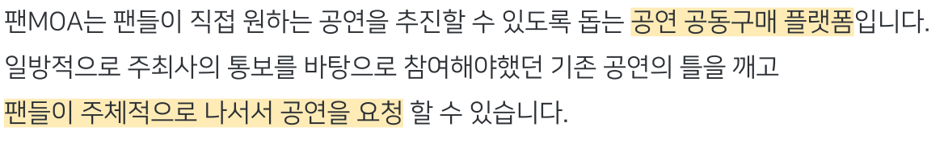



Slide 4


Slide 5



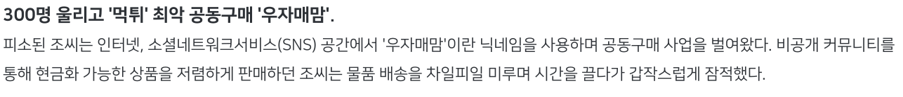


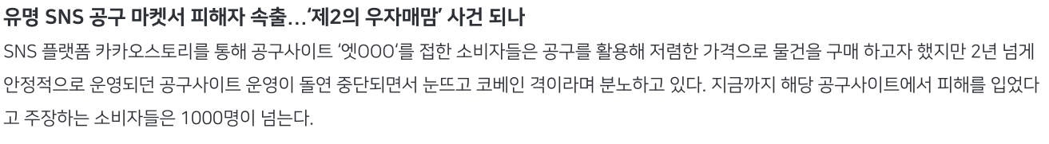

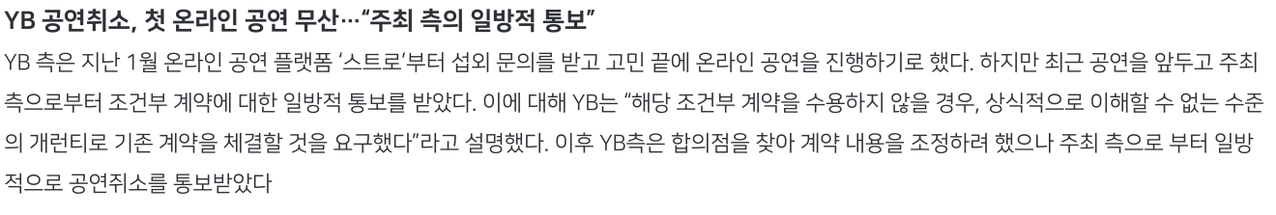

Slide 6


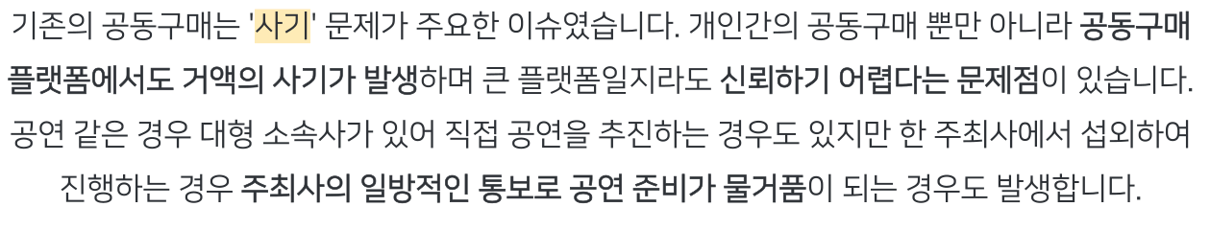

Slide 7








Slide 8








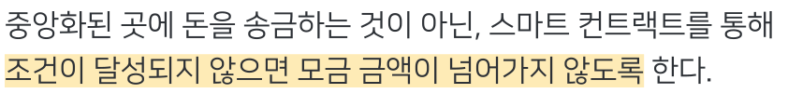






Slide 9


Slide 10










Slide 11





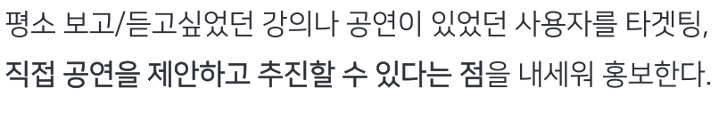































Slide 12






















Slide 13


Slide 14















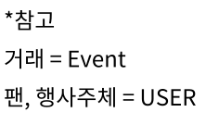




Slide 15










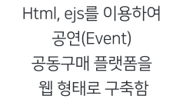
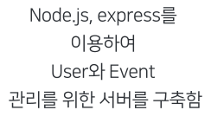
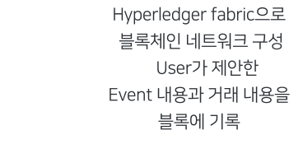




Slide 16

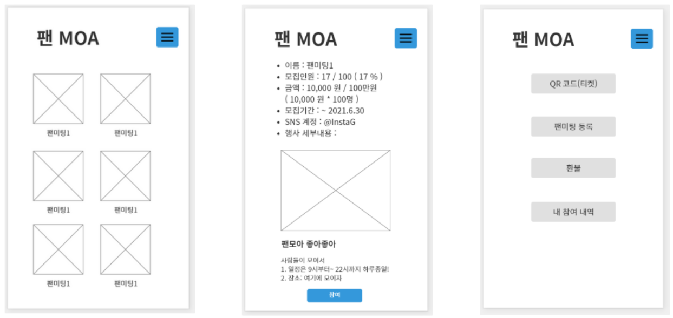








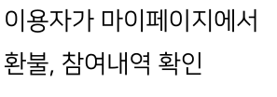


Slide 17


Slide 18

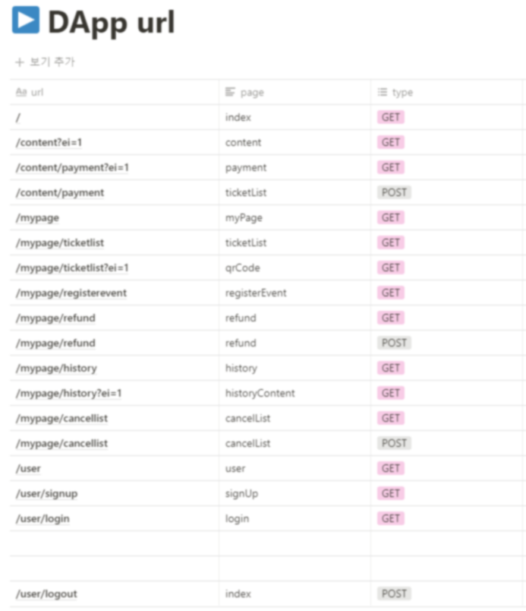
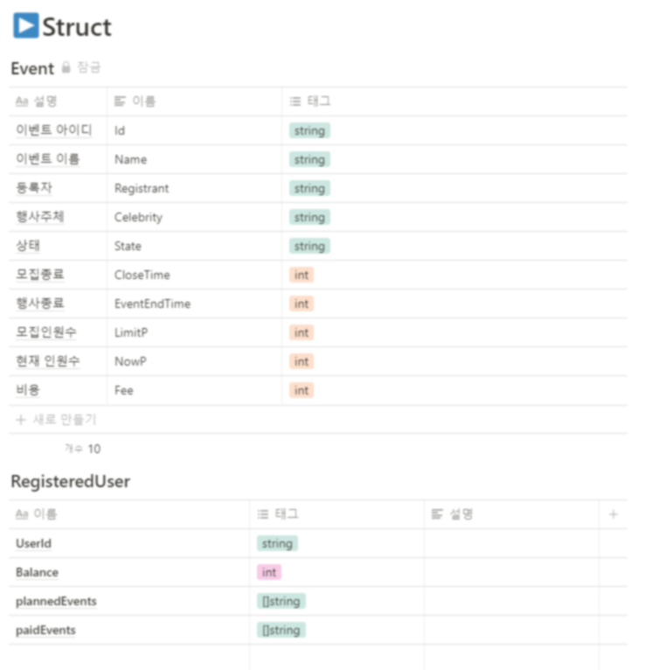

https://www.notion.so/Chain-Code-ce4f43e26244417ba623cebfb914993e

Slide 19



Slide 20

소스코드 github : https://github.com/hahahihiho/FanMOA
기획서 notion: https://www.notion.so/FanMOA-0b24c95b2bd644149baac30fa90f69f4

